Slide 1
EV Charging Station Dilemma
Group 6
Li Zhang
Parth Milind Bhingarde
Yusang Wei
Divya Lakshmipathy
Jiaxin Xu
Setu Vinod Macwan

Slide 2
Executive Summary
Where to Locate Electric Vehicle (EV) Charging Stations in Texas
Need for locating charging station
Factors contributing to this need
Regulations and Cost
Clustering analysis
Recommendation

Slide 3
01
WHY
Texas EV Outlook, The Big EV Push

Slide 4
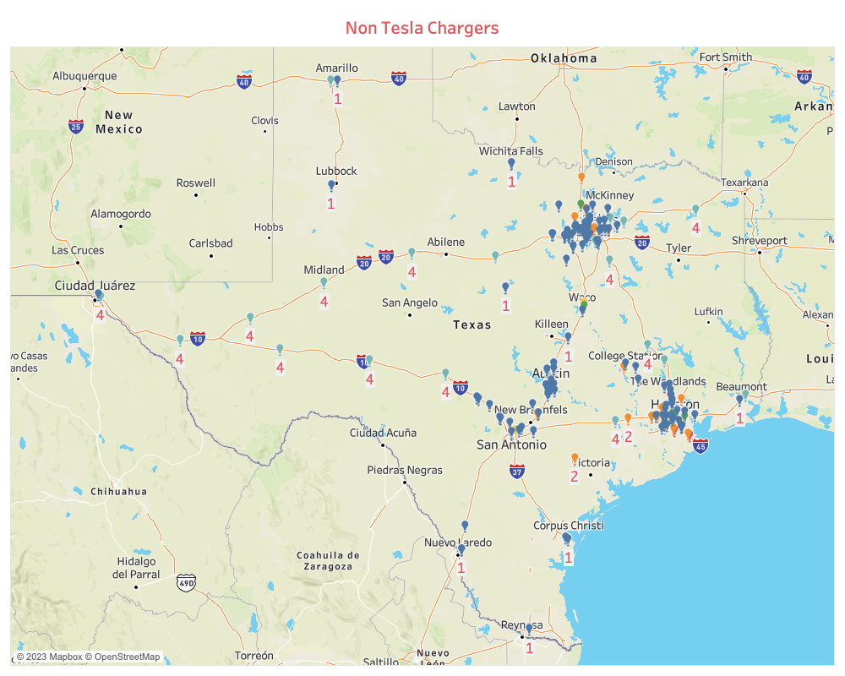

Texas EV Outlook
83%
17%
Dec' 2021
80,900
Dec' 2022
668,870
2394 Total Chargers
Tesla
Non-Tesla
302 Fast Chargers
113 Tesla Chargers

Slide 5
The Big EV Push
Ease of Use
Incentives
High Performance Low Maintenance
$2,500 rebate for buying an EV
$408 million funding over 5 years
Federal Orders
Commercialization
Government fleet vehicles to be 100% zero emissions
Adoption of EV's into supply chain
Clean city pledge

Slide 6
02
What
Problem Statement, Laws & Regulations, Cost Analysis

Slide 7

Laws & Regulations
Federal Highway Administration:
"New EV charging stations should be spaced 50 miles apart and within 1 mile of the Interstate exit along the designated Alternative Fuel Corridor highway"
State incentives - Texas' National Electric Vehicle Infrastructure (NEVI) Planning etc
Utility/Private Incentives - Commercial Electric Vehicle (EV) Charging Station Rebate - Austin Energy, Electric Equipment and Electric Vehicle (EV) Charging Station Incentive etc
Notes:
https://www.fhwa.dot.gov/environment/alternative_fuel_corridors/resources/nevi_program_faqs.pdf
https://www.fhwa.dot.gov/environment/alternative_fuel_corridors/exception-request-template.pdf
Laws and incentives: https://afdc.energy.gov/fuels/laws/ELEC?state=tx
State incentive: https://www.txdot.gov/projects/projects-studies/statewide/texas-electric-vehicle-planning-03-22-22.html
1 mile from the interstate exit, rated at 150kW or greater.
FHWA requirements of 50-mile spacing for DC Fast Chargers
Install DCFC chargers in a way that there are at least 4 ports to meet the National EV Infrastructure Standards and Requirements
The Texas Public Utilities Commission is authorized to exempt electric vehicle supply equipment from being regulated as a public utility.
Texas utilities join NEHC to ensure efficient and effective fast-charging programs, enable long-distance electric vehicle travel, avoid duplication among utilities, and complement existing corridor DCFC sites.

Slide 8
Why people do not choose Electric Vehicle
Long distance driving
Range anxiety
58% of Americans still have range anxiety and 49% fear being unable to find a charging station
Driving few hundred miles in a day is a common occurrence for many Texans
Initial higher upfront vehicle costs
Charging Time Trauma
According to The New York Times’ Americans are becoming more concerned with long charge times than the inability to find a charger
According to InsideEVs, over 40% of consumers report cost as a reason not to buy an EV. And EVs can cost at least $10,000 more than the equivalent gas-powered vehicle
The Texas EV registration amount in 2021 is only count 0.33% of the total registration amount
Notes:
Even though we have so many benefits for ev drivers but still didn’t see any significant increase of ev purchasing, and the Texas EV registration amount in 2021 is only count 0.33% of the total registration amount
the U.S. is lagging behind in the transition to EVs. The Wall Street Journal reports that 10% of vehicles sold globally last year were EVs, with Europe at 11% and China all the way up to 19%.
So we decided to find out why us customers do not choose ev, and here are the 4 main reasons:
1. Range anxiety is ppl fear the battery will run out of charge before reaching their destination, or fear of too few charging stations ++++
2. ++++ Charging an EV to full capacity could take at least 20 minutes, whereas refilling a gasoline tank can be done in a matter of minutes
3. ++++ Average EV travel range is around 250 miles per charge varies while gas cars are around 413 miles —nearly double what the average EV would cover.
4.
Registration amount - https://afdc.energy.gov/states/tx
Why ppl don’t buy ev - https://blinkcharging.com/fact-from-fiction-the-real-reason-why-consumers-dont-buy-electric-vehicles/?locale=en

Slide 9
Problem Statement
Establish a network of DCFC charging stations across the state of Texas to facilitate long-distance travel
Notes:
And base on that we decided our goal of this project ++++

Slide 10
Cost Analysis
Cost of Installing EV Charger
Factor | Level 1 | Level 2 | Level 3
Infrastructure | $80-$180 | $160-$2,000 | $10,000-$40,000
Installation | $0-$150 | $400-$1,700 | $4,000-$50,000
Total | $80-$330 | $560-$3,700 | $14,000-$90,000
Notes:
The locations to place Lvl 3 chargers need to be analyzed considering various factors:
Level 3 chargers are costly.
Level 3 chargers have faster charge times 30-60 mins.
Reserved for public and commercial networks
Since the cost is vastly different for the purpose of this project, we are only considering Level 3 chargers

Slide 11
03
How
Methodologies

Slide 12
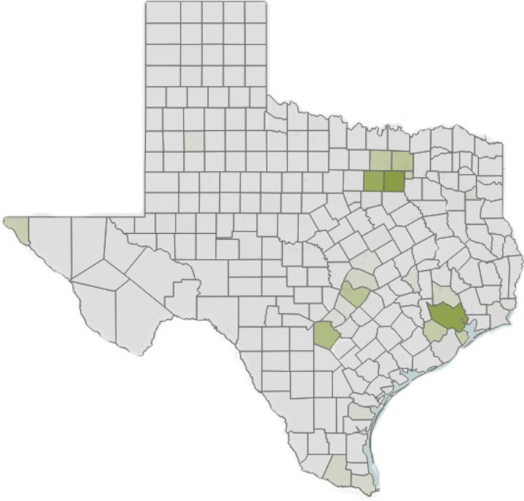
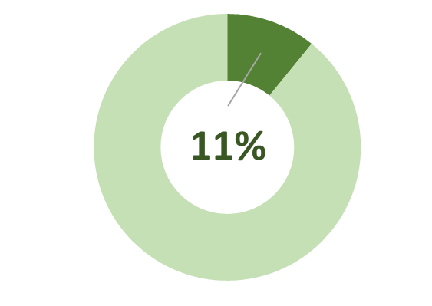
Methodologies
Categorizing counties in Texas as either urban or rural
Urban counties: constructing stations along the Electric Alternative Fuel Corridor and at rest areas
Rural counties: focus on building stations in close to county seats
31 of 254 counties in Texas are considered urban area
Notes:
++++ Based on the Texas Department of Agriculture, any area with a population density of more than 200 people per square mile is considered urban area, otherwise are considered as rural. ++++

Slide 13
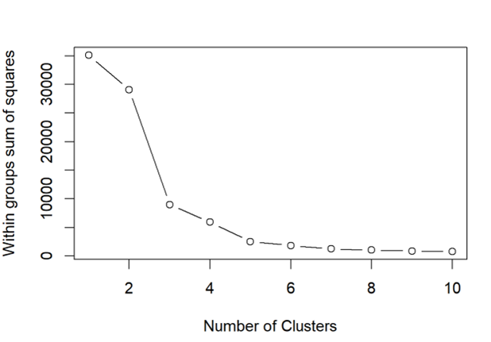
Clustering Analysis
Clustering based on the distance between existing DCFC charging stations
Identified 4 clusters, computed centroid of data points within each cluster
Calculated Euclidean distance between station locations & centroid
Average distance approx. 54 miles
Notes:
Identified 4 clusters & calculated Euclidean distance, and found out there is about 54 miles between each cluster centers
And this meet the 50-mile criteria from Federal Highway Administration

Slide 14
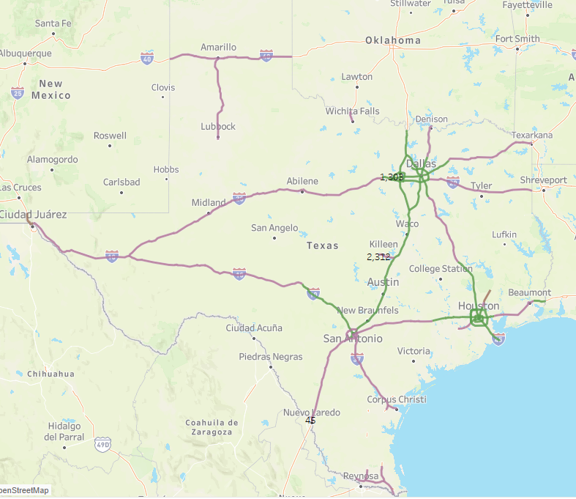
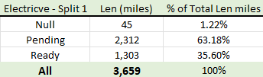
Electric Alt fuel corridor
We can tell the corridor is connecting the 4 major cities (clusters) in Texas: Houston, Austin, Dallas, and San Antonio
Establish DCFC stations at intervals of approximately 54 miles (from clustering analysis) along the electric alternative fuel corridors
3659 / 54 ≈ 67
EV stations along corridors
Notes:
The Electric Alternative Fuel Corridor is a network of charging stations that spans across the state and provides a reliable and efficient charging infrastructure for electric vehicles (EVs). The Texas corridor is part of a larger initiative by the U.S. Department of Transportation (USDOT) to establish a national network of alternative fuel corridors for EVs and other alternative fuel vehicles.

Slide 15
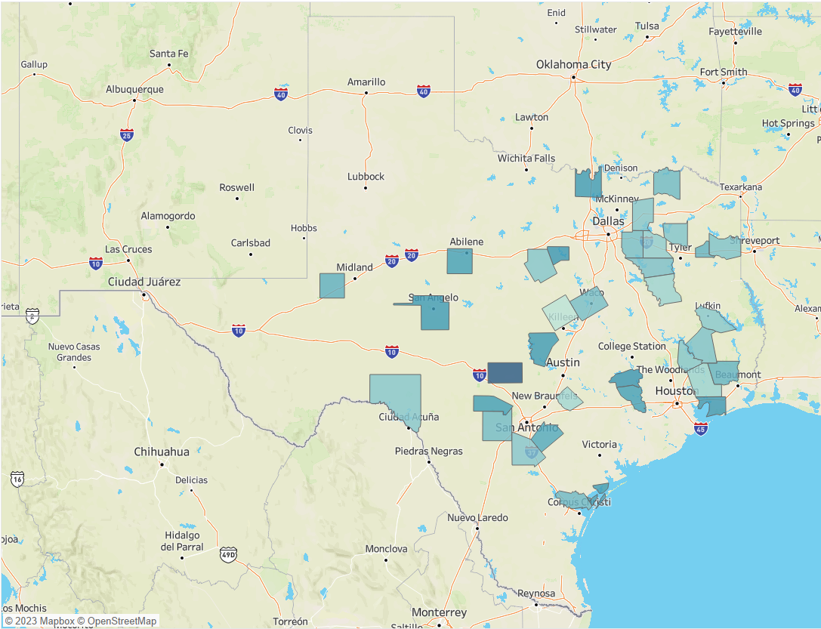
Counties w/o EV stations
EVs Registration: 400+
DCFC Chargers: 0
Color Gradient: Income
Stations: 66
Notes:
Busy counties in terms of EV Registration
Idea: account for counties with registrations but w/o stations
Argue: These are remote places and people already have in-home chargers
Despite, to ensure an extra option in case of natural circumstances.
Power loss
Technical bug
Need for a quick charge.
Color: Per capita Income. Profit perspective.
Areas:
Rural: County Seat
Urban: Close to major highways, Rest Areas.
Resource: https://evadoption.com/ev-charging-stations-statistics/charging-stations-by-state/

Slide 16
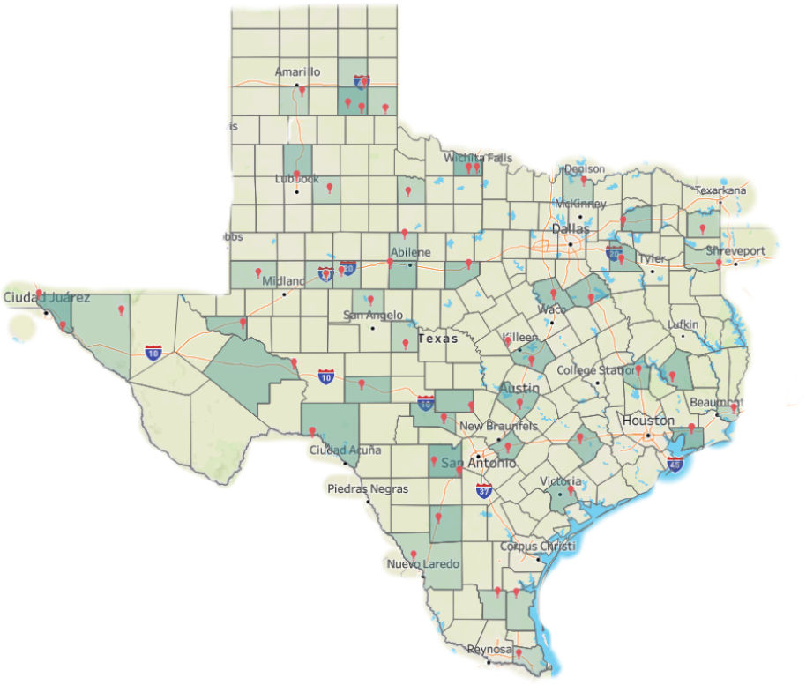
Targeted Rest Areas
Rest area
Counties
69
39
Total Chargers
69 * 4 = 276
Notes:
Talking about rest areas, we next looked at all rest areas in Texas.
Perfect for:
Long distance travelers
Reduce charger downtime (30-40 mins).
Close to highways.
We pinpointed 69 rest areas where Level 3 stations can be built.
Across 39 counties

Slide 17
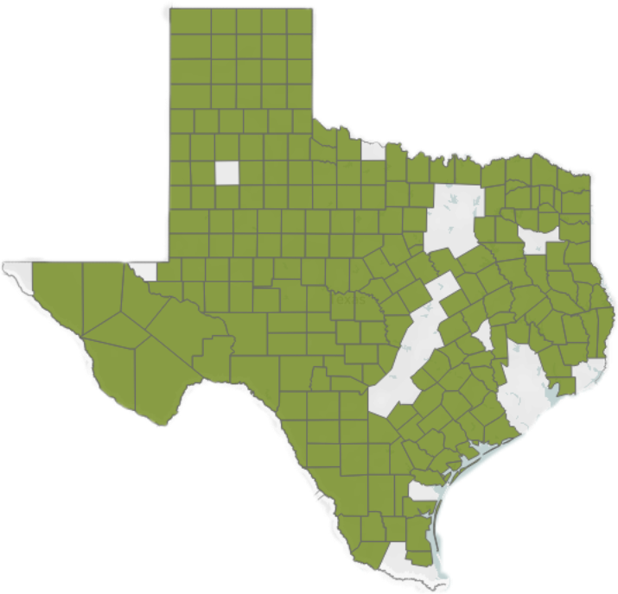
Rural area County Seats
To ensure convenient access to charging stations in the remaining 223 rural counties, we have decided to give priority to the construction of DCFC chargers near each county seat
By adopting this approach, we aim to increase the total number of charging stations by 223
Notes:
A population density of more than 200 people per square mile is considered urban area, otherwise are considered as rural.

Slide 18
04
SO WHAT
Recommendations

Slide 19
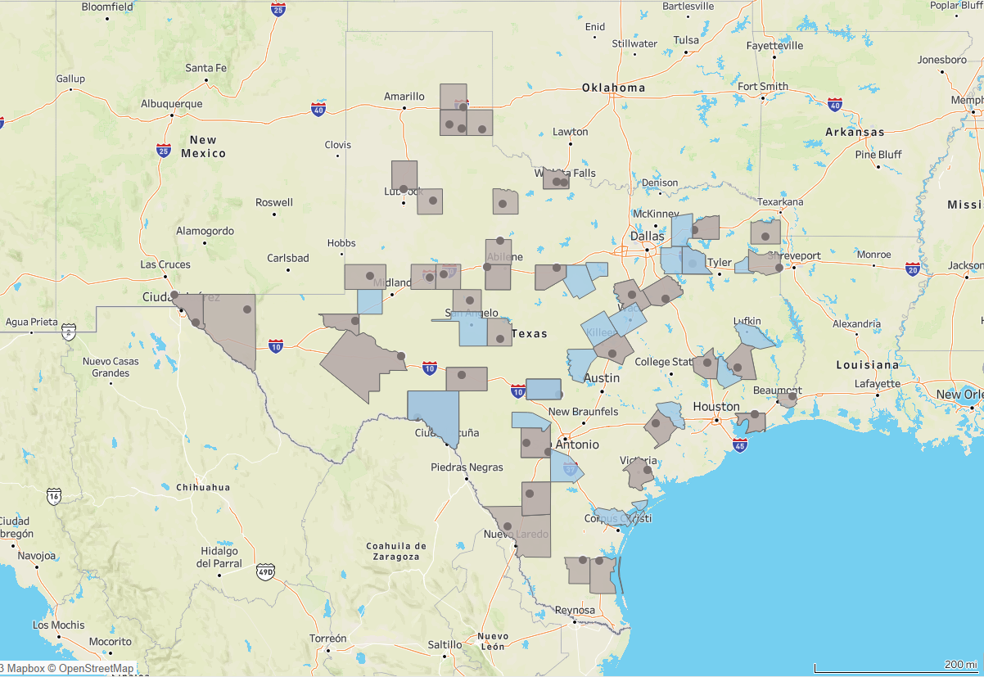
Recommendations
Method | # of new stations | # of chargers
Alt Fuel Corridors | 67 | 268
Counties w/o stations | 66 | 264
Rest Areas | 69 | 276
Rural counties | 223 | 892
Total | 425 | 1700
Total Cost
$64.6M
Notes:
Before After maps
Tables with numbers for new additions of EV stations

